Slide 1

Experiment 5 Back Propagation
Acknowledge to: Guoqiang Zhong
Organizers: Guoqiang Zhong, Zhaoyang Niu
Machine Learning Research Group
Ocean University of China
Qingdao, China

Slide 2

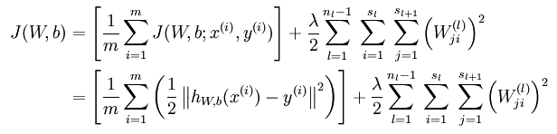
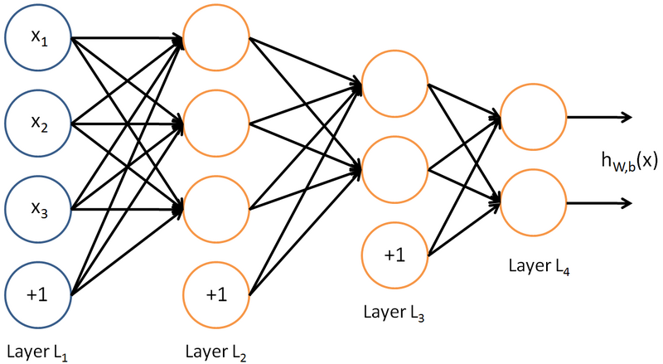
MLP & Back propagation
Cost function:
[(0, 1), 1]
[(1, 1), 0]
[(0, 0), 0]
[(1, 0), 1]

Slide 3
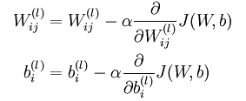
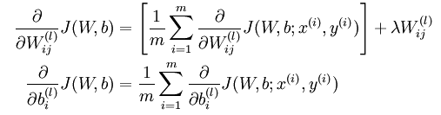
Gradient descent
Derivative of the overall cost function J(W,b):

Slide 4
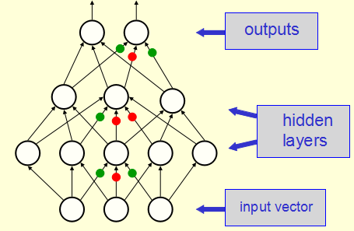
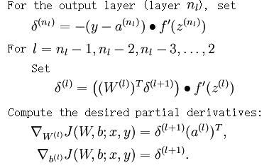

The algorithm

Slide 5
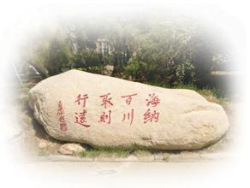
Experiment
Use the dataset for the experiment of k-NN classifier.
Write the Python code of a 4-layer MLP (including 2 hidden layers) to solve the classification problem, and compare the results of this MLP and your k-NN classifier.
Submit your compressed code, result and report in one week to DL2021Spring@163.com. The code should be reproducible, the result includes the comparison of the classification accuracies obtained by MLP and k-NN classifier on the test set, while the report introduces the detailed process of your experiments.

Slide 6
Thank you!

